Slide 1

Instacart
Data science challenge – Analytics Focused
Prajakta Gujarathi – 8/30/2019

Slide 2
Assumptions:
Duplicates are due to error in data collection technique.
Same order having multiple records are because orders are delivered in parts or there were multiple items in single order and issues are reported based on item/delivery time.
We are trying to build customer support team which helps customer in end to end process from placing order online to getting it delivered and support after that.

Slide 3
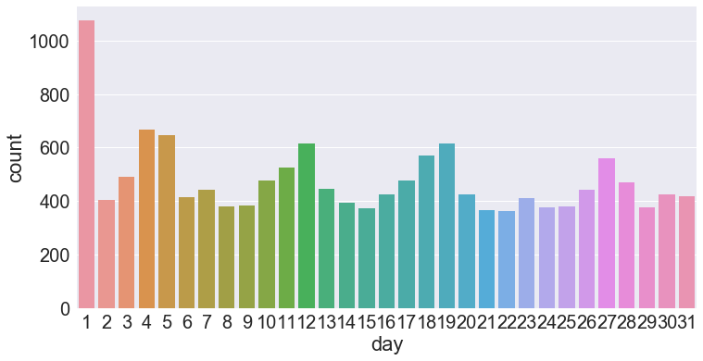
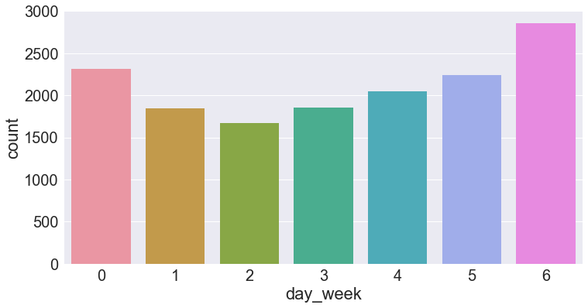
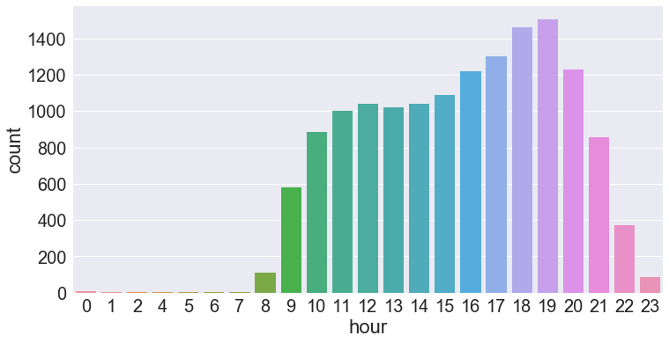
Data Exploration
Data shows expected customer behavioral patterns, like most of the order are delivered or 1st of the month, on weekends and between normal hours (9am-9pm)

Slide 4
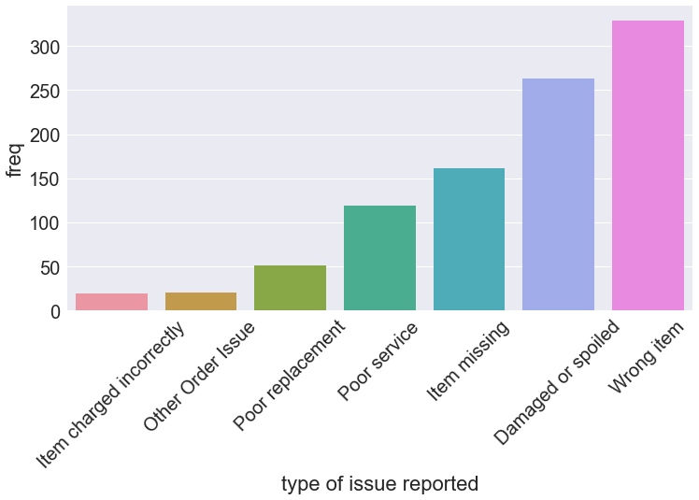
Insights about Instacart business
13845
There are 13845 unique orders placed in 2014 between may and June.
Out of which, issues where reported on 886 orders i.e 6.4%.
Out total customer ratings 78% of orders have 5 start ratings.
Instacart has more business in SF and Chicago than NYC.
Most of the issues reported are in the category of Wrong item, damaged or spoiled, item missing and poor services

Slide 5
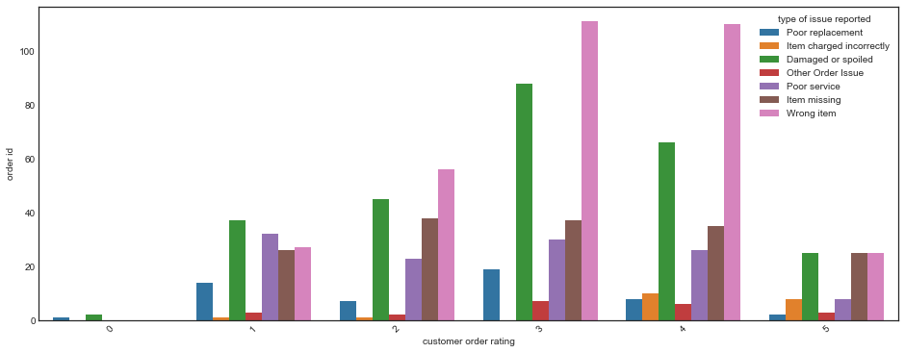
Type of issues reported
Could not find clear correlation between issues reported and customer ratings.
But most of the issues reported have customer rating in range 1-4
With Wrong item , damaged/spoiled ,poor service in leading.

Slide 6
Additional data that might help
Delivered items data will help to know which items were wrong items, Like customer asked for organic strawberries but regular were delivered or they were looking for specific brand and other ones where delivered.Also which are most damaged / spoiled item and how we can expedite the delivery.
Shopper data, shopper score, vehicle used for delivery.
Grocery store information, which might be used to calculated distance between store and customer delivery address for efficient delivery.

Slide 7
Building customer support team:
ProActive Support: Create team or application which will automatically check availability, conditions of items, in order placed by customer before shopper reaches store to pick up order for delivery.
If there is damaged or out of stock items let customer know about it and give refund back or ask for extended more delivery time. (This will minimized wrong orders and damaged/spoiled issues) (This will minimized wrong orders and damaged/spoiled issues)
Keep track of price being charged and any change in price of item to mitigate issue of item charged incorrectly.
Shopper level support: Building a team which can go through shoppers background, application which will keep shopper score depending on customer reviews, mistakes, delivery conditions etc. Providing shopper with hotline number that they can use if they face any kind of problem with delivery.
Keep shoppers motivated by giving them incentives

Slide 8
Continue..
Ask shopper to take pictures after delivery with the time and places where order was left.(front door/porch/leasing office) (This will minimize item missing issue)
After Delivery support: Have online, phone, email customer support team If customer wants to reports a issue or have question with delivery and payments.
In case customers are not satisfied give refund back, as well keep track of customers that are reporting issues frequently. There might be pattern with customers reporting issues.
Ask customers for feedback and survey to improve future deliveries and check why ratings are low even if no issues are reported.

